Slide 1

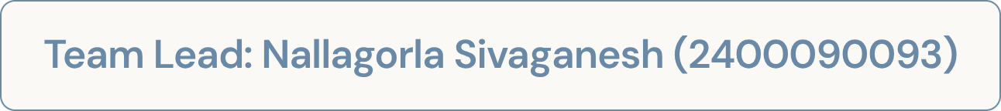
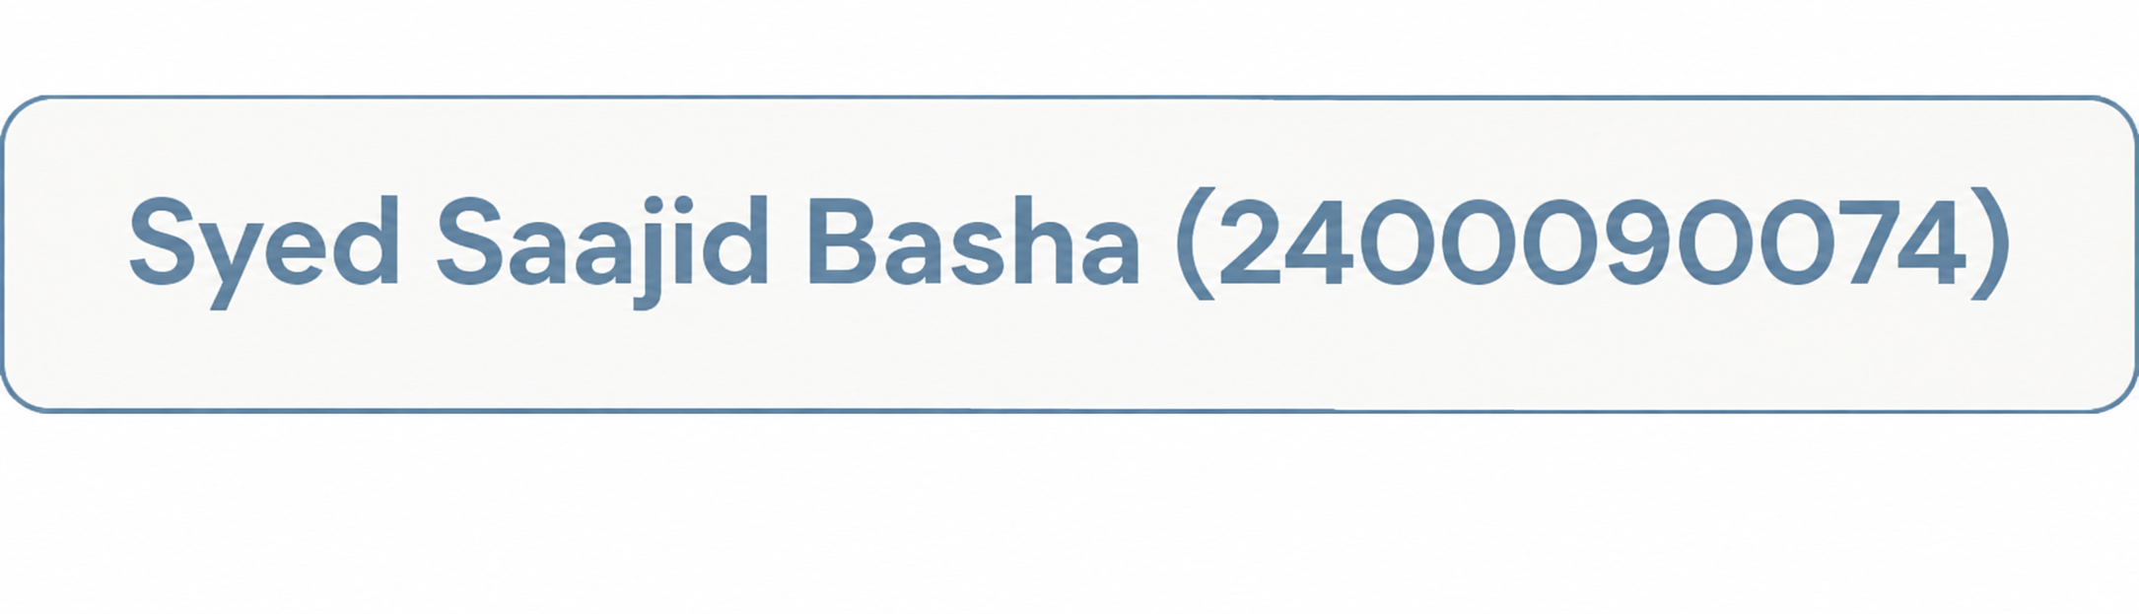
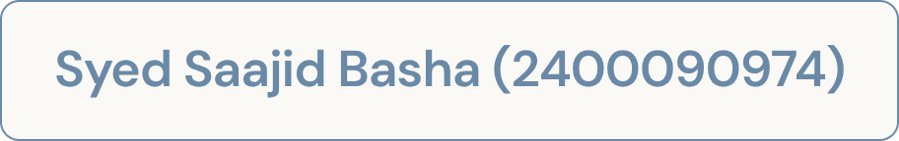
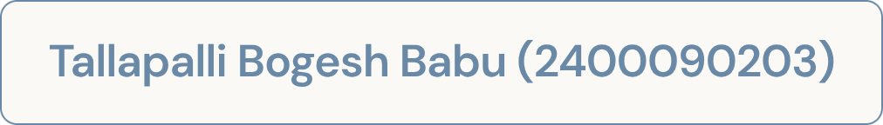
Starlight Stays & Resorts
Automated Reservation Platform Using Microservices
A distributed microservices-based platform to manage room search, real-time availability, bookings, and guest cancellations across the entire property portfolio.

Slide 2

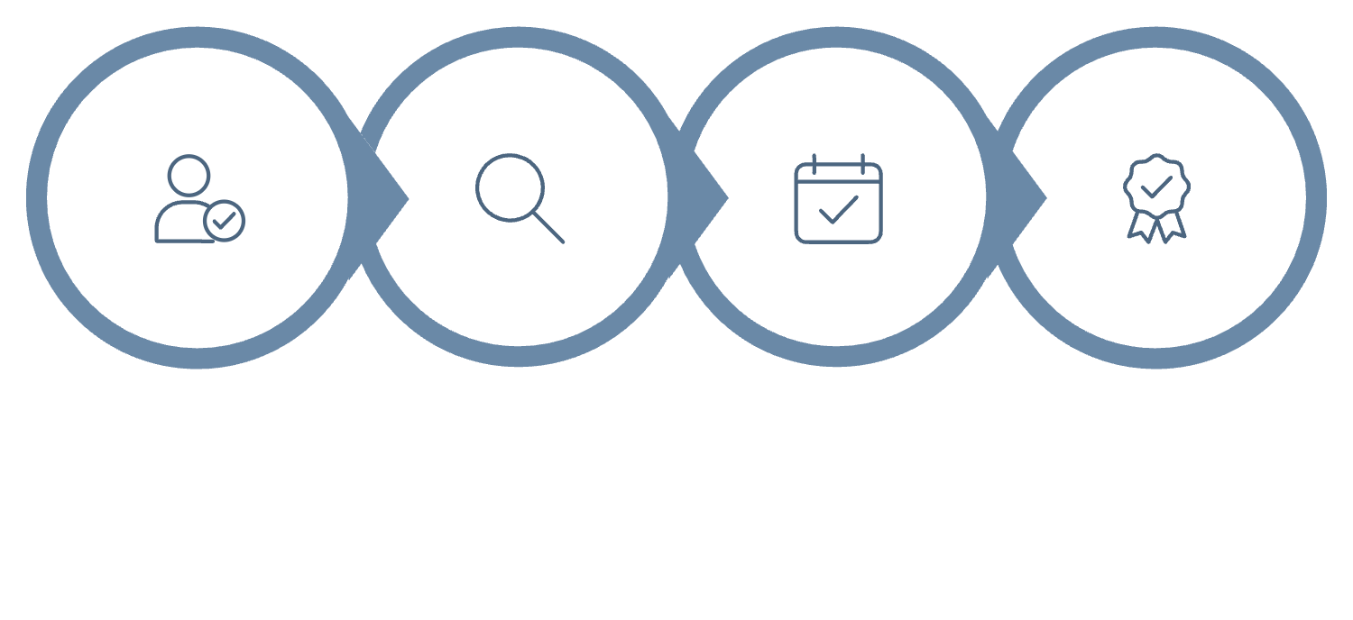
BUSINESS USE CASE
Why Starlight Stays Needs This Platform
Starlight Stays & Resorts requires an automated reservation platform to manage room search, real-time availability, bookings, and guest cancellations across its property portfolio. Manual or poorly synchronized systems lead to double bookings, incorrect availability, and delays during peak seasons.
The platform mandates microservices to address complex operational requirements:
JWT Authentication secures APIs, an API Gateway provides centralized routing, and Eureka Service Discovery enables services to find each other without fixed addresses.
Prevent Double Booking
Real-time date-range validation before confirming reservations
Book or Cancel
Dynamic Availability
Login
Search
Confirm
Automatically updates room inventory after every booking or cancellation
Peak Season Resilience
Scales independently to support high booking traffic

Slide 3
System Objectives & Core Tasks
The Starlight Stays platform is built around clearly defined objectives ensuring customers can search, book, and cancel rooms reliably — while operators maintain accurate, real-time inventory control.
Customer-Facing Capabilities
1
Allow customers to search available rooms, check real-time availability for selected dates, make reservations, view booking details, and cancel reservations. The system must prevent double booking and automatically update availability after every transaction.
Infrastructure & Security
2
Secure all APIs using JWT authentication. Route requests dynamically through an API Gateway acting as the single entry point. Register and discover all microservices through Eureka Server, eliminating fixed IP dependencies between services.
Development & Deployment Tasks
3
Design Room, Booking, and User services. Implement availability APIs, reservation and cancellation logic, and inter-service communication. Perform end-to-end testing of workflows from login through booking to cancellation, then deploy and verify all services operate correctly together.

Slide 4

Three Core Microservices
Each service owns its own responsibility, APIs, and data — enabling independent deployment, scaling, and resilience across the platform.
User Service
Room Service
Booking Service
Manages customer accounts and authentication. Handles user registration, login, profile management, password validation, JWT token generation, and user authorization. Exposes POST /users/register, POST /users/login, and GET /users/profile.
Manages room information and inventory. Supports adding rooms, updating room details, searching rooms, checking real-time availability, and updating availability. Exposes GET /rooms, GET /rooms/{roomId}, GET /rooms/availability, POST /rooms, and PUT /rooms/{roomId}.
Manages the complete reservation lifecycle. Creates bookings, validates dates, prevents double booking, stores reservation data, allows viewing and cancellation, updates booking status, and communicates with Room Service. Exposes POST /bookings, GET /bookings/{bookingId}, GET /bookings/user/{userId}, and DELETE /bookings/{bookingId}.

Slide 5




EMPATHY MAP
Understanding the Customer: Rahul Kumar
A survey persona was created to understand customer expectations, thoughts, actions, feelings, pain points, and needs while searching for and booking a hotel room.
Says & Thinks
Feels & Does
Pain Points & Needs
"I want to see available rooms before booking." "Is this room really available?" "I don't want my booking to fail after payment." Customers demand accuracy and want real-time status at every step.
Customers feel confident when availability is accurate, happy after successful booking, and relieved when cancellation is simple. They search rooms, select dates, compare options, book, confirm, and cancel when necessary.
Major pain points: incorrect availability, double-booking risk, slow responses, complicated cancellation, and service failures during high demand. Needs: real-time availability, fast search, secure login, immediate confirmation, and no double booking.

Slide 6
ARCHITECTURE
Booking Workflow & System Design
End-to-End Customer Journey: Login → Search → Book → Confirm → Cancel
Login & JWT Authentication
Customer logs in via User Service, which validates credentials and generates a JWT token. All subsequent API requests carry this token for secure access.
Search & Availability via API Gateway
Requests route through the API Gateway to Room Service, which provides real-time availability. Eureka enables services to discover each other without fixed addresses.
Booking & Double-Booking Prevention
Booking Service validates dates, checks existing reservations, and rejects overlapping bookings. Example: an existing reservation of 10–15 Sep blocks a new request for 12–18 Sep on the same room.
Confirmation & Cancellation
On success, Booking Service returns a Booking ID, room details, check-in/check-out dates, and status. On cancellation, Room Service is notified and availability is updated immediately.
Innovative Enhancements
Planned features include AI Room Recommendation, Dynamic Pricing, Smart Notifications (email/SMS), Chatbot Support, Personalized Offers, and Peak-Season Auto Scaling.
All microservices — User Service, Room Service, and Booking Service — register with Eureka Server, enabling dynamic discovery and routing through the API Gateway without fixed IP dependencies.

